Slide 1

Interference of Light
MD. GULAM MUSTAFA
Lecturer (Physics)
Department of Science & Humanities
Bangladesh Army International University of Science and Technology (BAIUST)
Syedpur, Cumilla-3501

Slide 2

Whatever we will discuss
  Interference of Light and its classification
  Some important definitions
  Conditions to observe Interference
  Conditions to form Constructive and Destructive Interference
  Understanding of Path difference and Phase difference

Slide 3
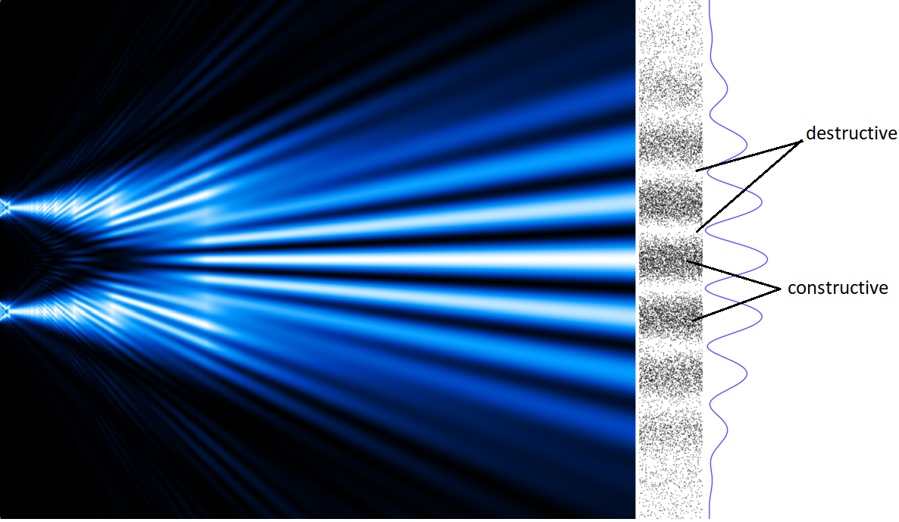
INTERFERENCE OF LIGHT
Due to superposition of two light waves emitted from coherent sources intensity of light increases at some points and decreases at other points. As a result alternate bright and dark state is produced on a plane. This occurrence is called the interference of light.
Fig: Interference of Light

Slide 4
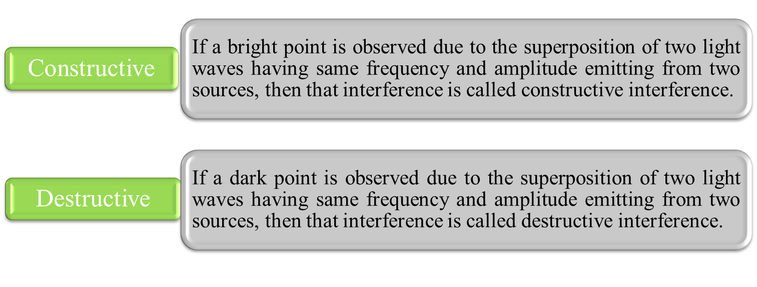
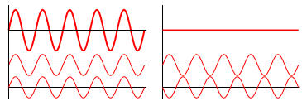
Types of Interference
Same Phase
Opposite Phase

Slide 5



Important Definitions
If two waves cross through a particle of a medium simultaneously, then each wave will displace that particle. As a result, there will be a resultant displacement of the particle. This resultant displacement will be equal to the sum of individual displacement by the two waves. This is called the superposition of waves.
If light-waves of the same wavelength are emitted from two sources with a particular phase difference and if that phase difference is maintained all along during propagation then those sources are called coherent sources.
If interference occurs on a plane or on a screen then alternate bright and dark mutually parallel lines or bands are found. These alternate bright and dark lines or bands are called interference fringes of light.

Slide 6
Conditions for Interference
The light sources should be coherent.
The amplitudes of the two waves producing interference should be equal or almost equal.
The sources should be very close to each other.
The sources should be very narrow.
The sources should be monochromatic-that is, of a single wavelength.

Slide 7


Conditions of Constructive and Destructive Interferences
Those points where path difference of the two waves is even multiple of λ/2, constructive interference will be produced there.
i.e., Path difference = 2n · λ/2, where n = 0, ± 1, ± 2, … etc
Those points where path difference of the two waves is odd multiple of λ/2, destructive interference will be produced there.
i.e., Path difference = (2n + 1) · λ/2, where n = 0, ± 1, ± 2, … etc

Slide 8


Understanding of Path Difference and Phase Difference
Path difference is nothing but a linear distance between two waves.
Phase difference is nothing but an angular distance between two waves.

Slide 9


